Slide 1
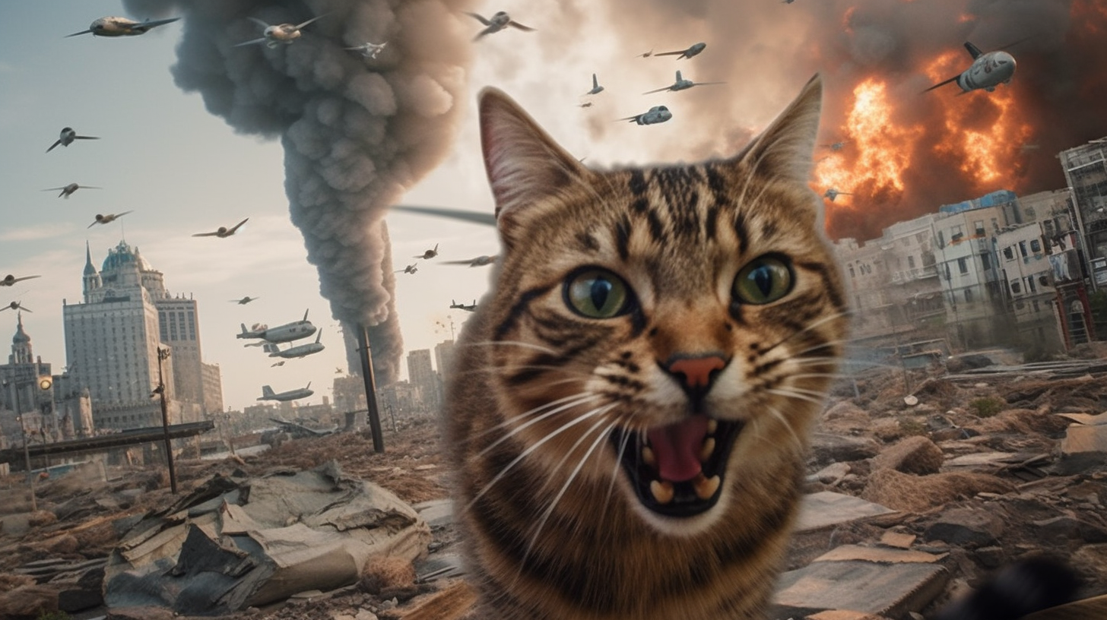
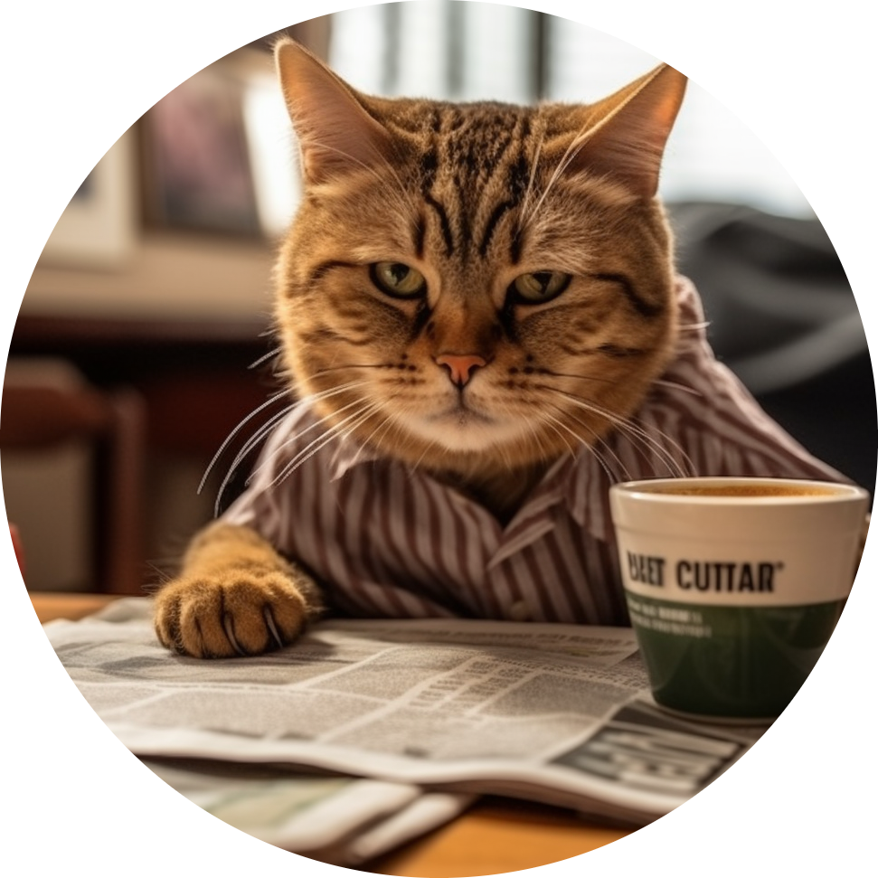


Ironhack Final Project - Ralph Ward

Slide 2


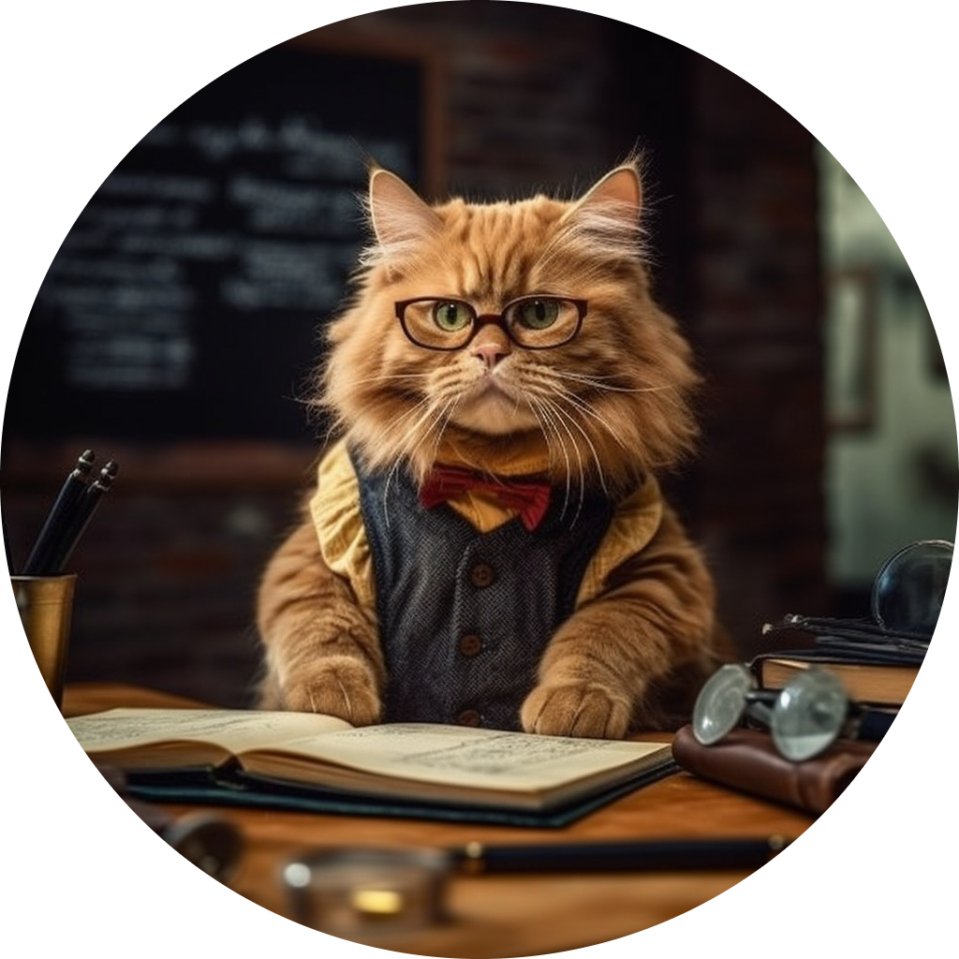
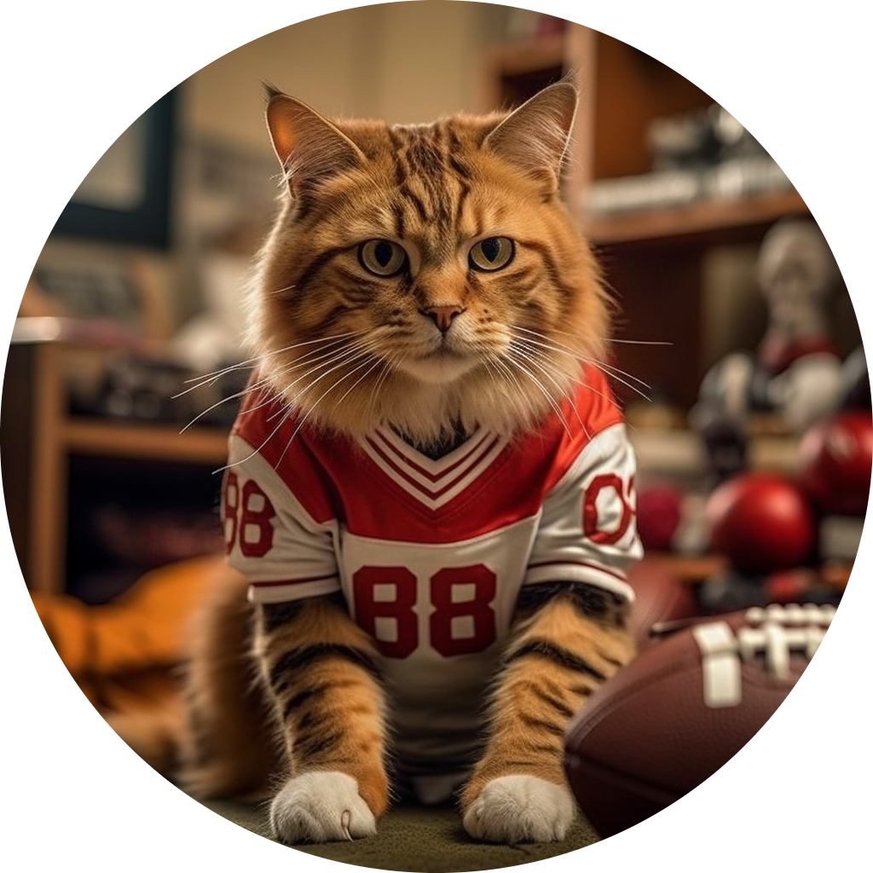
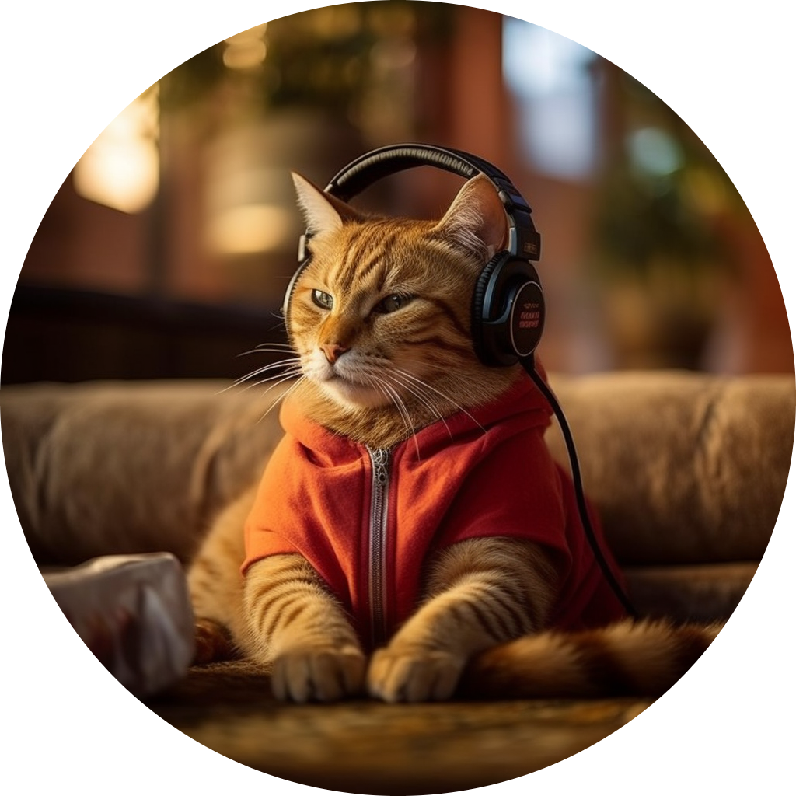


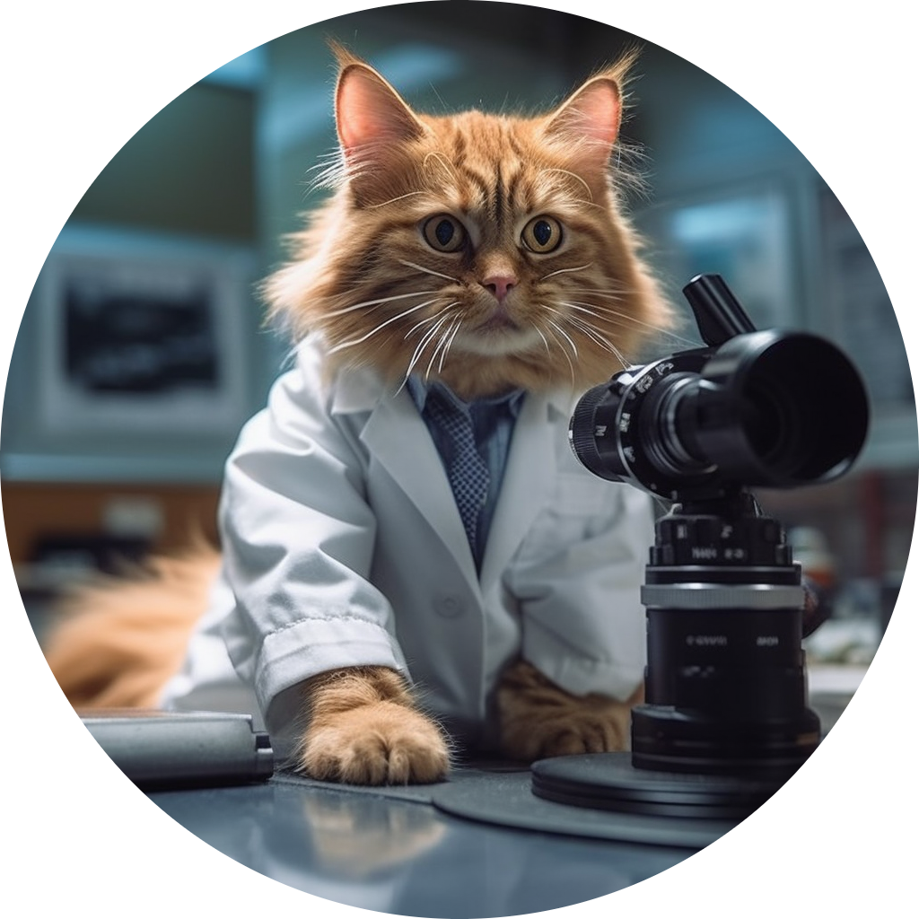
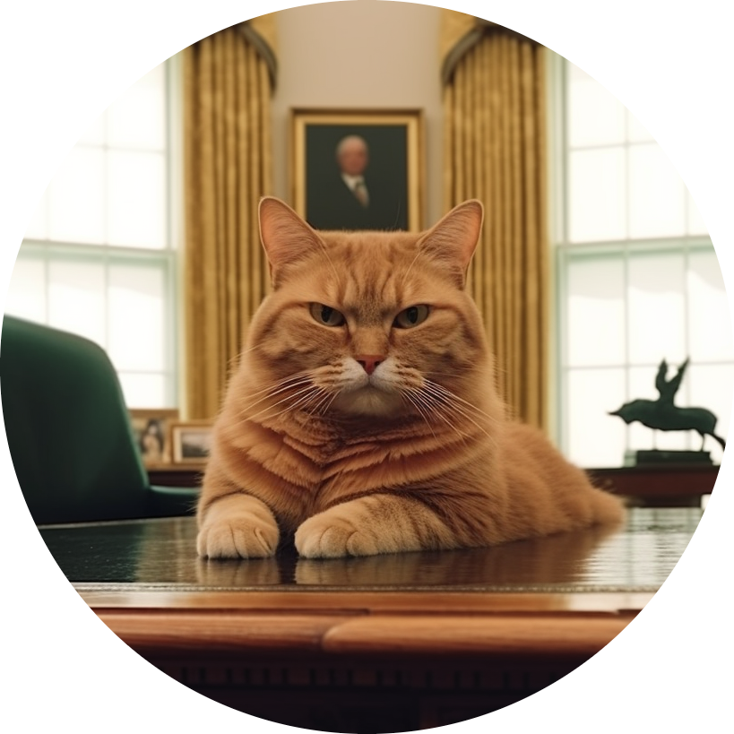
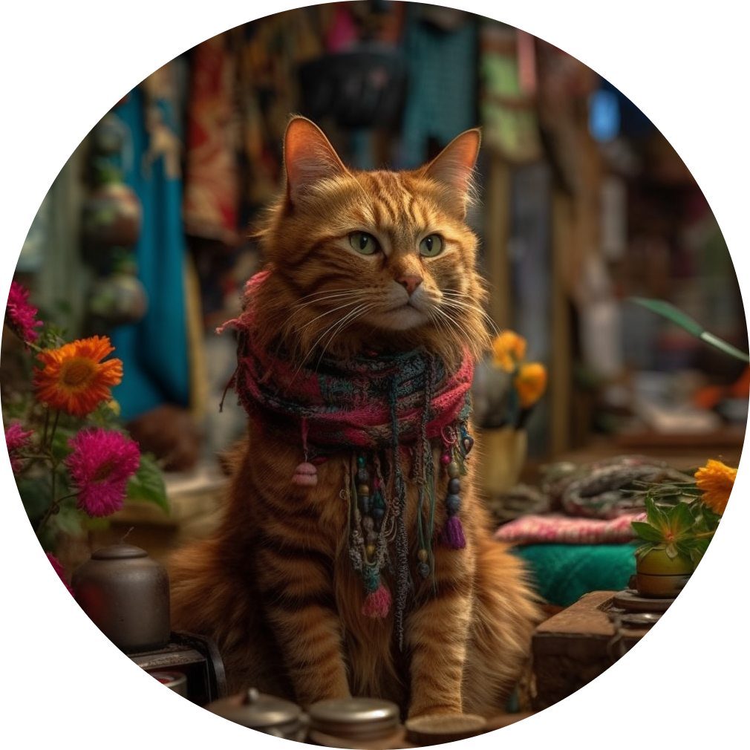
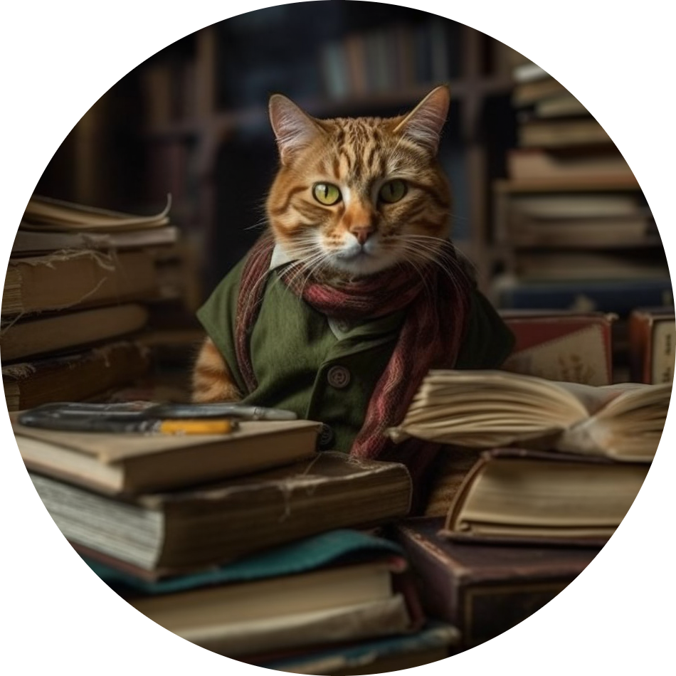
Objective
What?
A daily satire news outlet brought to you by cat memes on social media
How? Reddit as a source
Vetted and human-curated content
Trends before hitting mainstream news
Why?
News is evergreen content
Satire is laughable and cats are a staple of internet humor
Virality potential: news, reddit hotness & voting, memes, shareability on social media

Slide 3
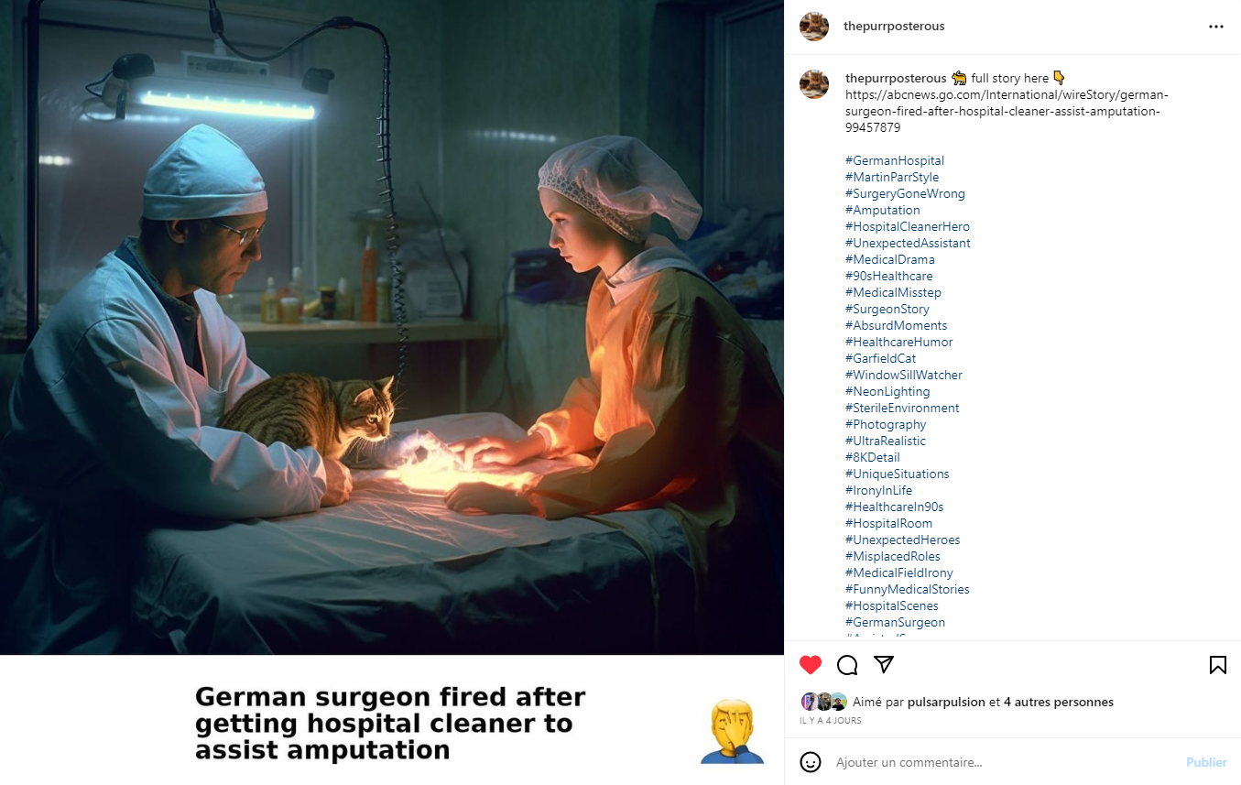
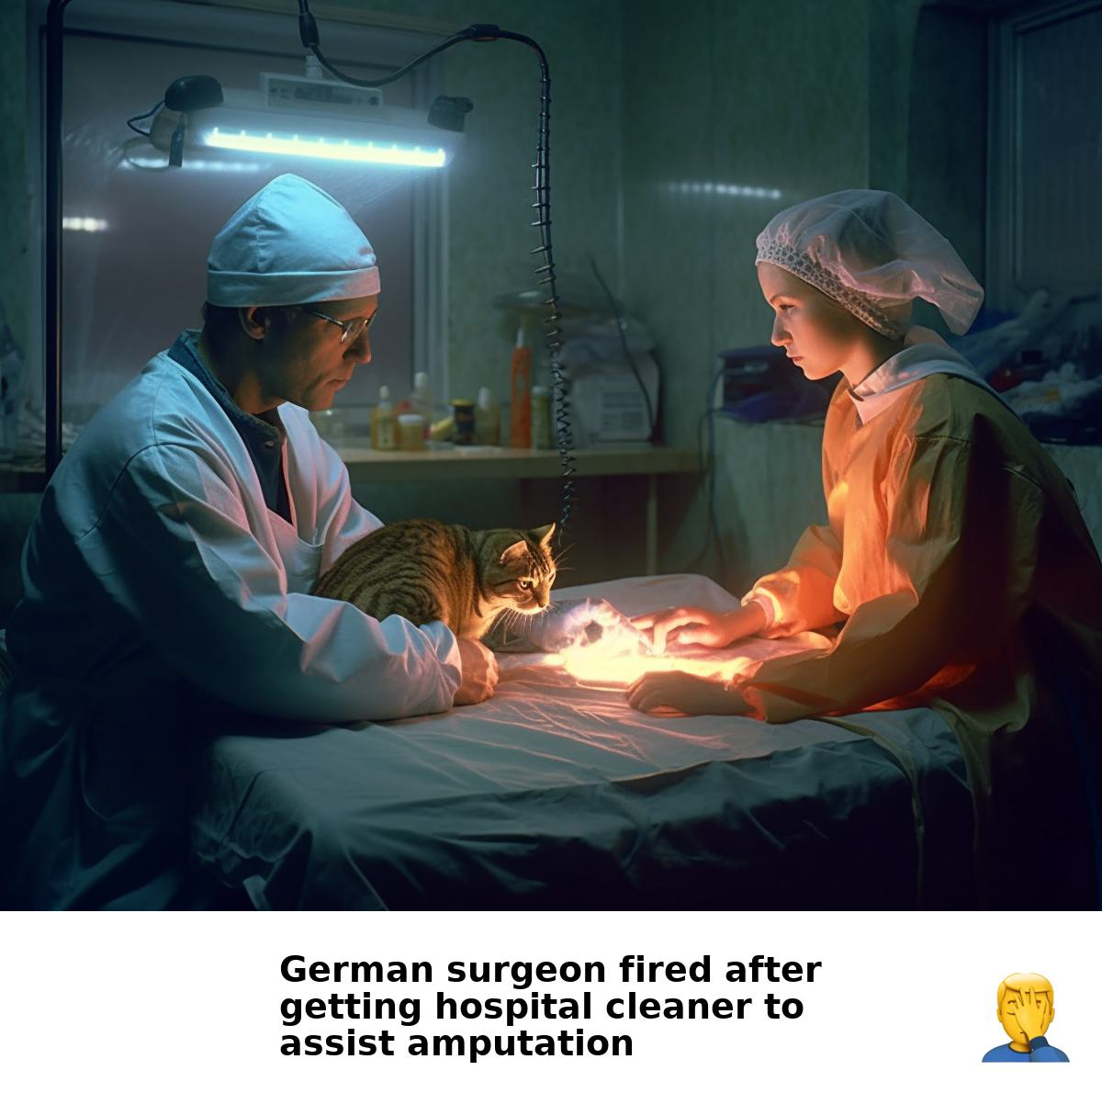
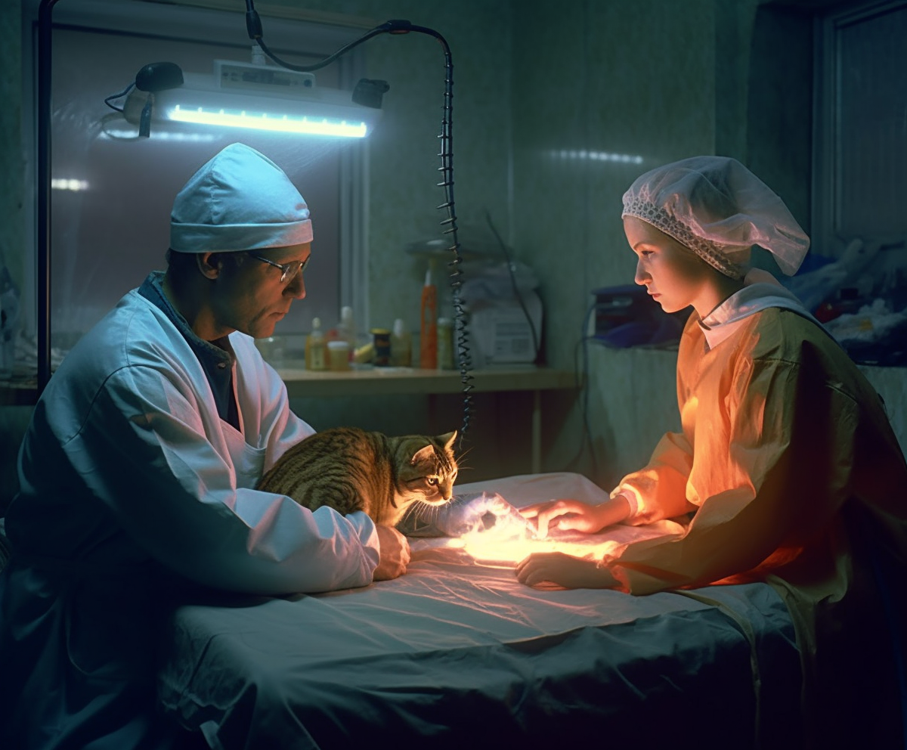
Workflow
⛔ Ignore
🥱
😡
🤖 Machine learning classification
📥 Fetch posts (Reddit API)
💬 Sentiment analysis
🤩
“German surgeon fired after getting hospital cleaner to assist amputation”
https://abcnews.go.com/International/wireStory/german-surgeon-fired-after-hospital-cleaner-assist-amputation-99457879
WELLNESS
😊
POSITIVE
📲 Post to Instagram (bot)
💫 Image transformation
🎨 Generate image (Midjourney bot)
📝 Generate story (ChatGPT API)
/imagine prompt: Through Steve McCurry's 50mm lens, a hospital cleaner, visibly overwhelmed, stands in a surgical room while she is reluctantly guided by a commanding surgeon. On the operating table, a startled Garfield-like cat under bright surgical lights that cast stark shadows and bring out the sterile sheen of the room. Hyperrealistic, ultra-detailed, 8K resolution --v 5.1 --stylize 1000 --ar 6:5

Slide 4


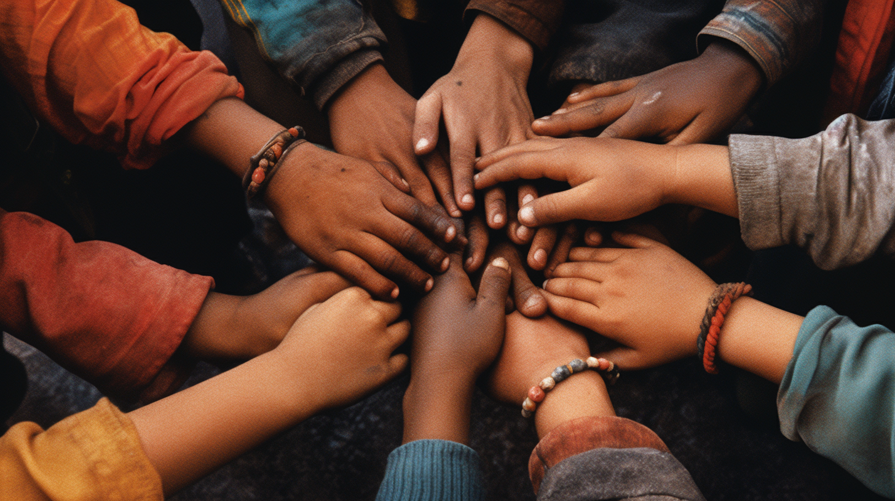
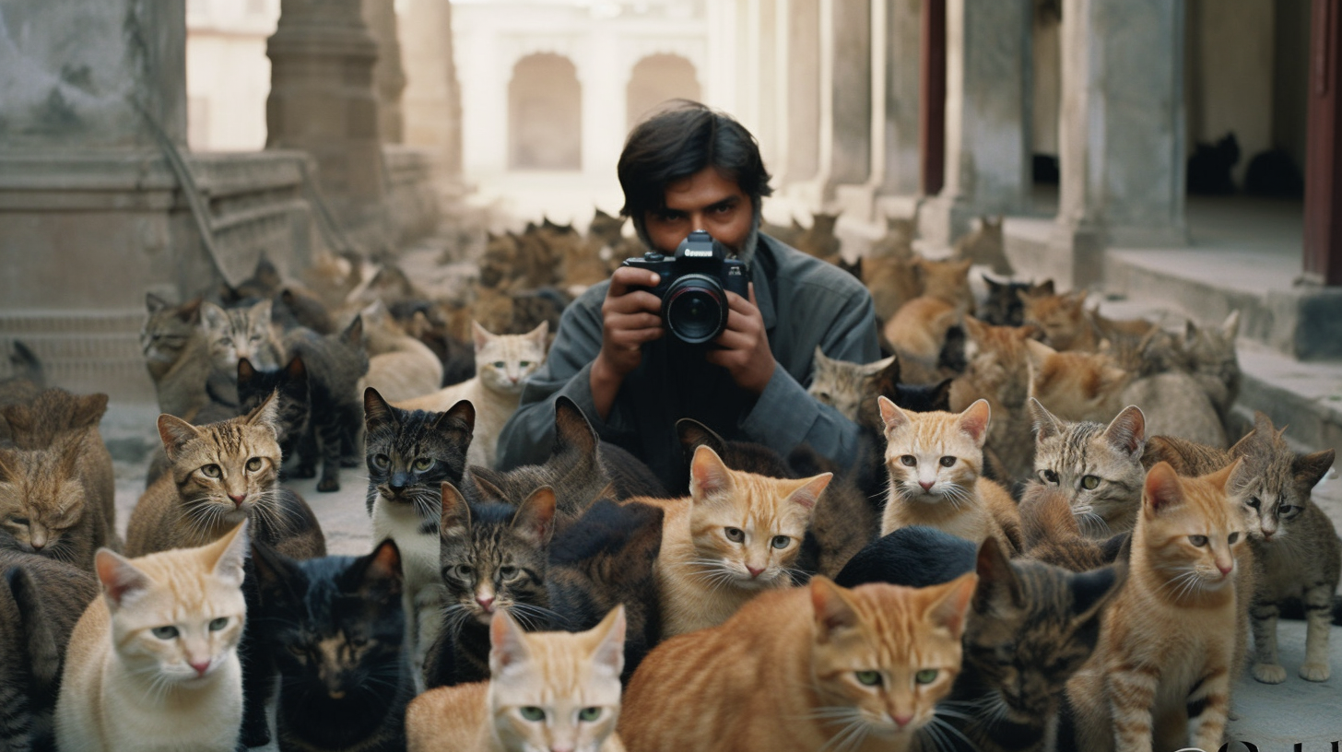

Focus on lightheartedness
👍 | 👎
 | 🖕🏽 Disrespectful 🤬 Hateful 🩸 Harmful ⚔️ Violence 🍆 Nudity
Non-dividing content
Removing sensitive topics with machine learning
Inclusive content
Removing negative topics with sentiment analysis
No blocking on Midjourney
No banning on Instagram
Universally enjoyable
Cats and emojis 🐱 galore

Slide 5
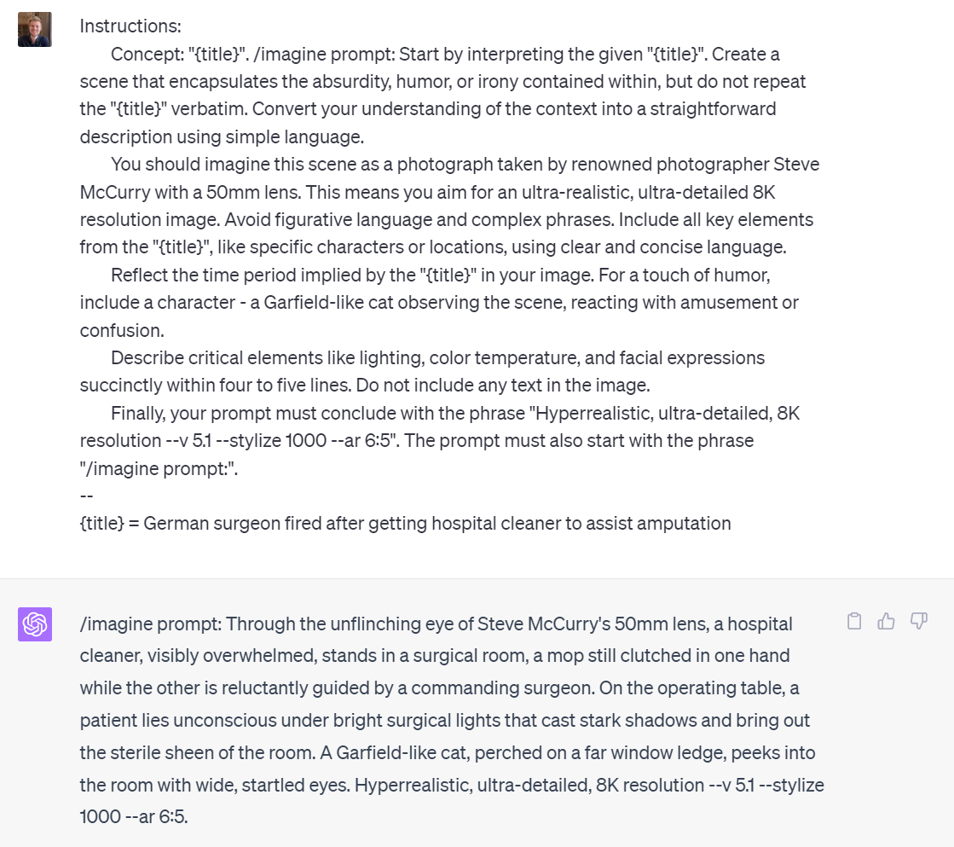
Harnessing the Power of AI
Text generation
ChatGPT LLM for storytelling and prompt engineering
Hashtag generation
Image generation
Midjourney for ultra realistic and vivid scenes

Slide 6
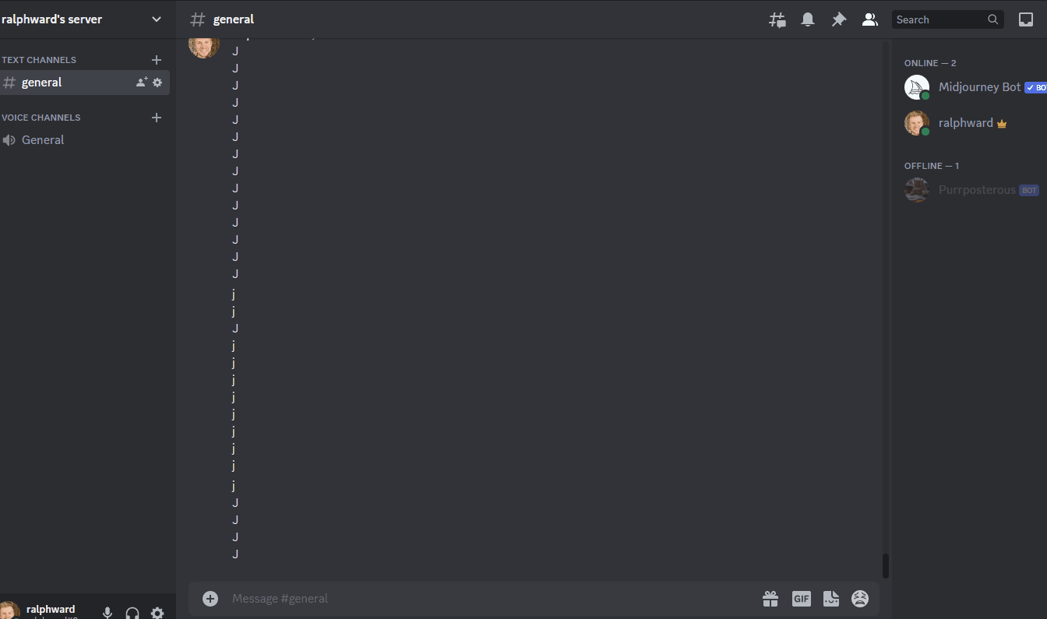
Ease of use
Automation & bots
Managed within Discord
Instagram bot
Mobile friendly
Manageable on the go

Slide 7


Thank you!
https://github.com/ralphmartynward/ironhack_09_final-project
https://www.instagram.com/thepurrposterous/

